Slide 1



American Alliance for International Education
(AAFIE)
Smart Manufacturing
智 慧 制 造

Slide 2
Predictive Maintenance Menus
Menu/菜单 B – a
Preprocessing
预处理
Menu B – a
Data Loading, Sampling Strategies and Scope Definition
上载数据，取样策略，估算数据需求

Slide 3
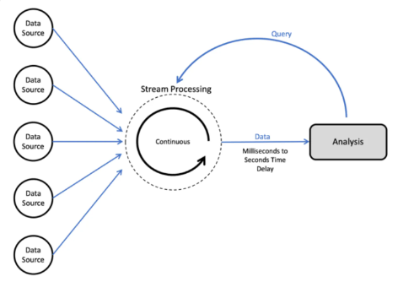
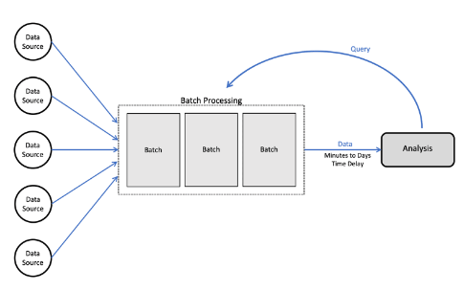
Data Loading/ 上载数据– Ref: A Separate Deck/ 参照 Data Loading 文稿
Two main categories: batch and streaming.
两大类：批处理/数据流

Slide 4
Sampling Strategies / 取样策略
Five Basic Sampling Methods
Simple Random.
Convenience.
Systematic.
Cluster.
Stratified.
五种基本抽样方法：
简单随机取样
简单采样
系统抽样
整群抽样
分层抽样

Slide 5
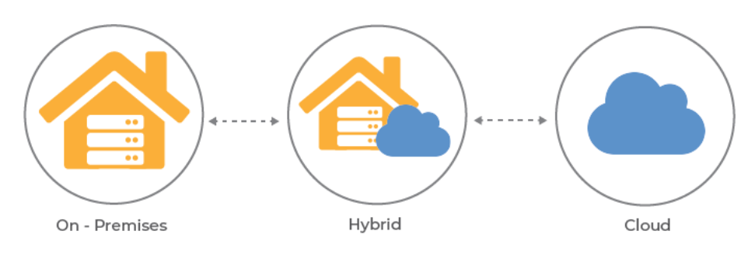
Scope Definition/ 估算数据需求
Data Volume, Processing Cost, Storage Cost, Infrastructure requirements, on-premise or cloud decision/or hybrid decision.
数据量、处理成本、存储成本、基础设施要求、本地或云决策/或混合决策。

Slide 6
Predictive Maintenance Menus
Menu/菜单 B – b
Preprocessing
预处理
Menu B – b
EDA / 探索性数据分析

Slide 7
EDA/探索性数据分析 – Ref: A Separate Deck/ 参照 EDA 文稿
Exploratory Data Analysis (EDA) is the crucial process of using summary statistics and graphical representations to perform preliminary investigations on data in order to uncover patterns, detect anomalies, test hypotheses, and verify assumptions.
In simple words, EDA is a data exploration technique to understand the various aspects of the data. EDA is often used to see what data may disclose outside of formal modelling and to learn more about the variables in a data collection and how they interact. It could also help us figure out if the statistical procedures we are considering for data analysis are appropriate. Before modelling the data, it gives insight into all of the data and the numerous interactions between the data elements.
探索性数据分析 (EDA) 是使用汇总统计和图形表示对数据进行初步调查以发现模式、检测异常、检验假设和验证假设的关键过程。
简而言之，EDA 是一种数据探索技术，用于理解数据的各个方面。 EDA 通常用于查看在正式建模之外可能会泄露哪些数据，并了解有关数据收集中的变量以及它们如何交互的更多信息。 它还可以帮助我们确定我们正在考虑进行数据分析的统计程序是否合适。 在对数据进行建模之前，它可以深入了解所有数据以及数据元素之间的众多交互。

Slide 8
Predictive Maintenance Menus
Menu/菜单 B – c
Preprocessing
预处理
Menu B – c
Preprocessing and pipeline planning/ 预处理及流程计划

Slide 9
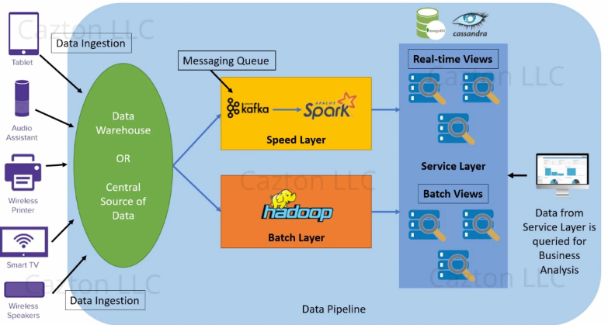
Data Loading/ 上载数据
Pipeline planning: 流程计划

